Slide 1
晶体管的开关特性

Slide 3
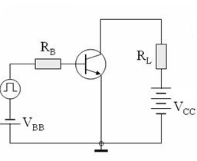
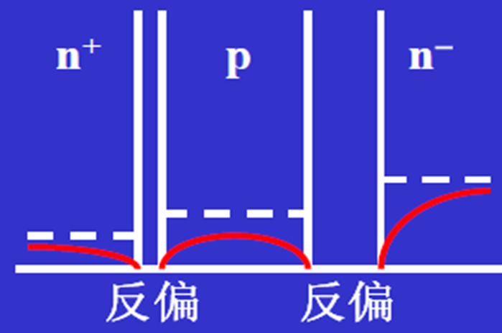
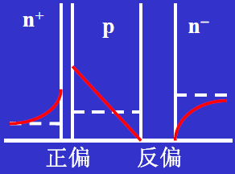
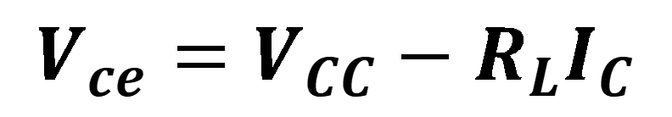
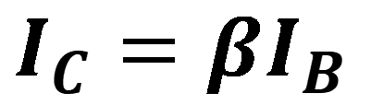
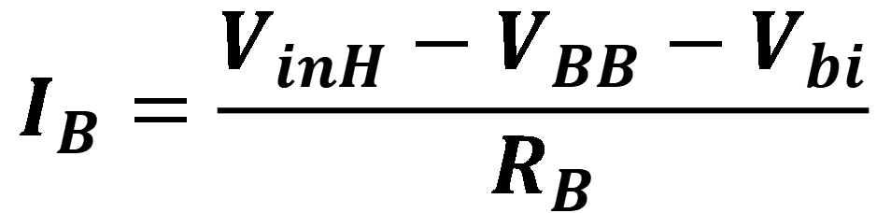
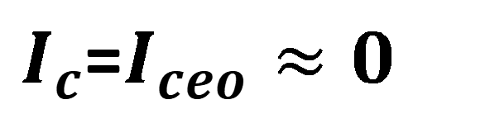
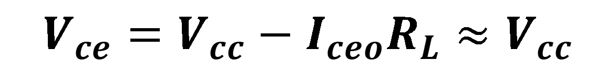
晶体管的开关作用
截止
$I_{c}$=$I_{ceo}≈0$
$$V_{ce}=V_{cc}−I_{ceo}R_{L}≈V_{cc}$$
$$I_{B}=\frac{V_{inH}−V_{BB}−V_{bi}}{R_{B}}$$
$$I_{C}=βI_{B}$$
$$V_{ce}=V_{CC}−{R_{L}I}_{C}$$

Slide 4
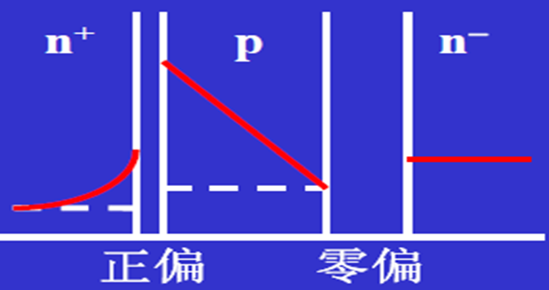
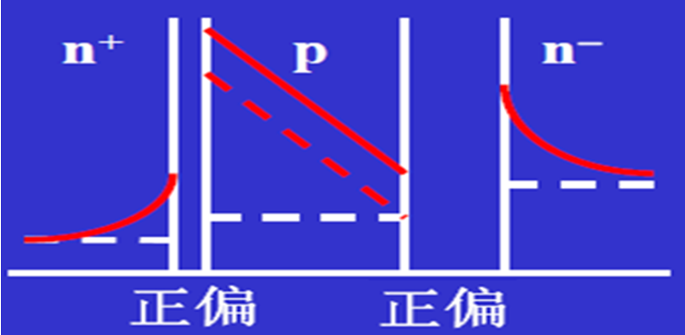
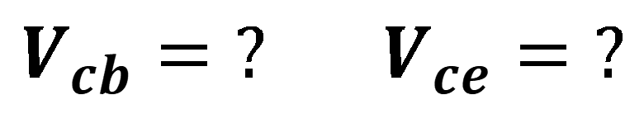
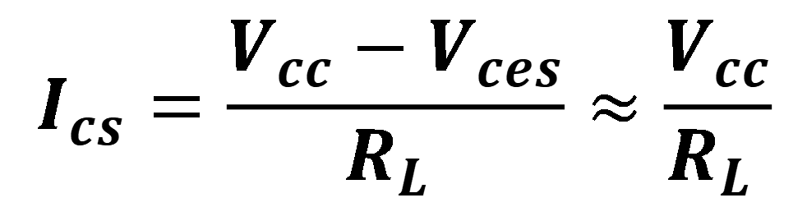
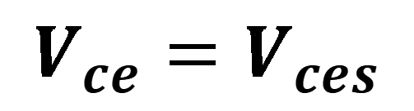
$${V_{cb}=? V}_{ce}=?$$
$$I_{cs}=\frac{V_{cc}−V_{ces}}{R_{L} }≈\frac{V_{cc}}{R_{L} }$$
导通
$$V_{ce}=V_{ces}$$
开关管的要求：
① V_{ces}越小越好，最好→0; ② I_{ceo}越小越好，最好→0
③ BV_{ceo}高（使用范围大）; ④ 开关时间短

Slide 5
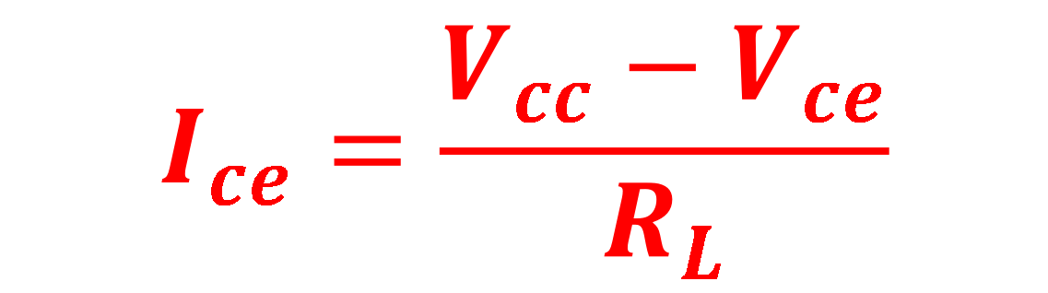

$$V_{ce}=V_{cc}−R_{L}I_{ce}$$
$$I_{ce}=\frac{V_{cc}−V_{ce}}{R_{L}}$$

Slide 6
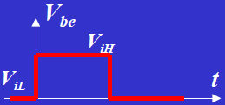
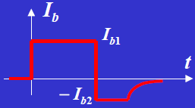
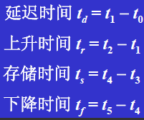
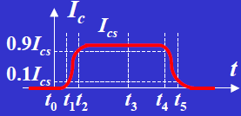
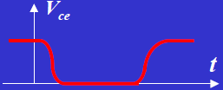
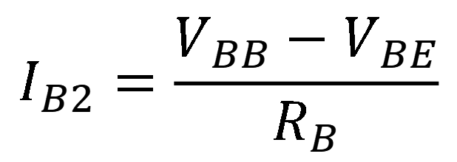
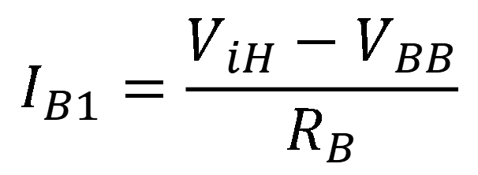
晶体管的开关过程
$$I_{B1}=\frac{V_{iH}−V_{BB}}{R_{B}}$$
$$I_{B2}=\frac{V_{BB}−V_{BE}}{R_{B}}$$

Slide 7
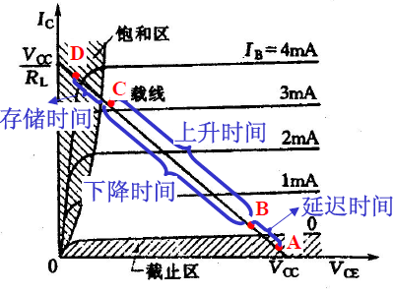
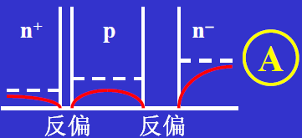
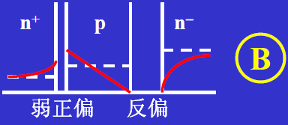
延迟时间内t_{d}
加上输入阶跃脉冲至输出电流达到最终值的百分之十（ 0.1 I _{C}( sat )） 之间所经历的时间。它受到下列因素的限制：
发射结从反向偏置到正向偏置

Slide 8
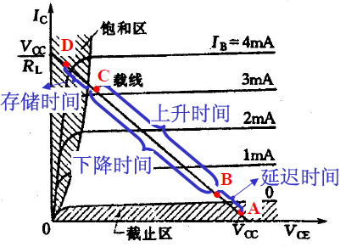
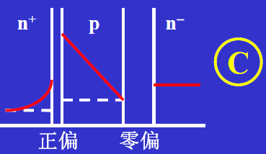
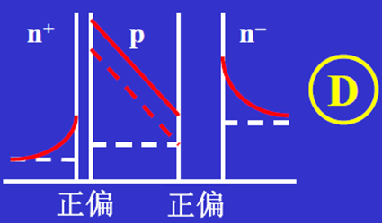
2、上升时间t_{r}

Slide 9

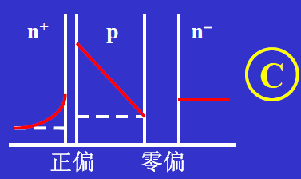
3、存储时间t_{s}
集电极电流下降到0.9 I _{C}(sat) 之间的时间。
在限制开关晶体管的开关速度方面，这是最重要的参数。当晶体管处于饱和状态时，发射结和集电结两者均为正向偏置。过量载流子超过了保持有源工作模式的需要。晶体管输出电流在这部分过量载流子被去除之前不能改变。因此，贮存时间对应于去除这部分过量少数载流子所需要的时间。

Slide 10

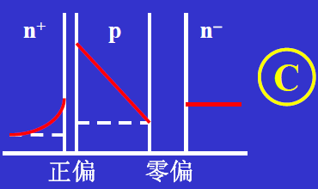
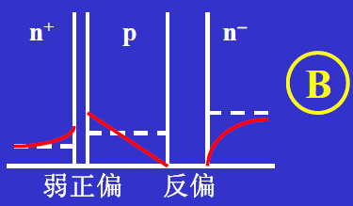
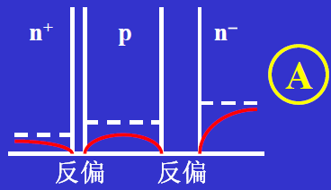
4、下降时间t_{f}
表示集电极电流从它最大值的百分之九十下降到百分之十的时间间隔。这是上升时间的逆过程，

Slide 11
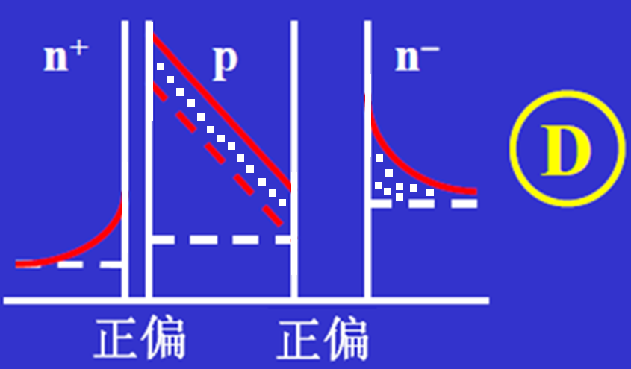
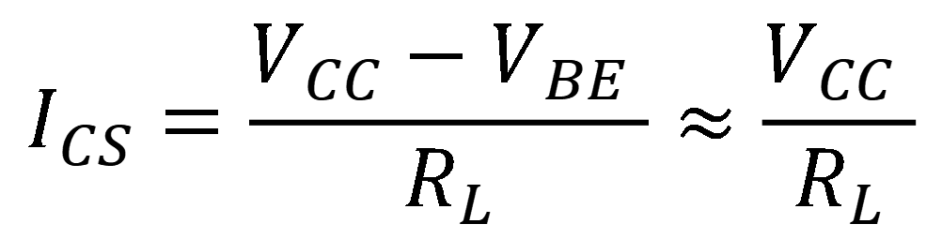


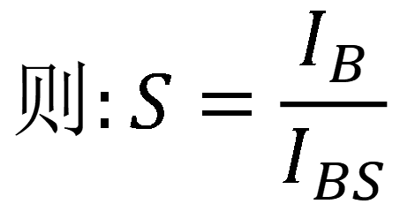
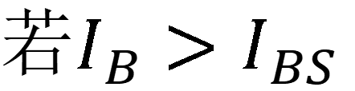
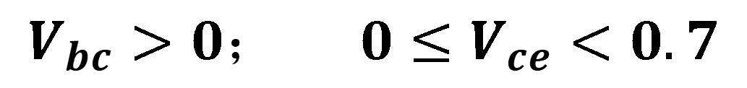
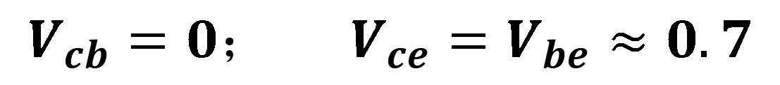

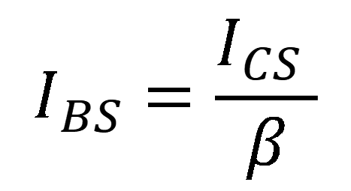
饱和深度
$${V_{cb}=0； V}_{ce}=V_{be}≈0.7$$
$${V_{bc}>0； 0≤V}_{ce}<0.7$$
临界饱和时$，$
若$I_{B}>I_{BS}$
$$I_{CS}=\frac{V_{CC}−V_{BE} }{R_{L}}≈\frac{V_{CC} }{R_{L}}$$
$$则:S=\frac{I_{B}}{I_{BS}}$$
此时$，$
$$I_{BS}=\frac{I_{CS} }{β}$$
$S$即为饱和深度

Slide 12
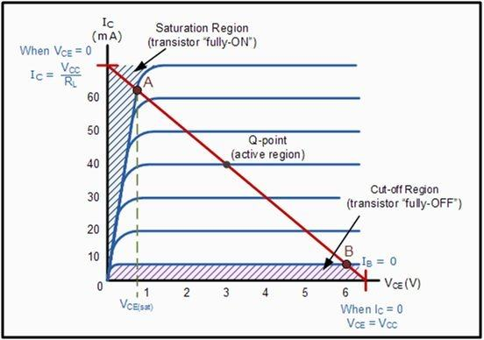
非饱和开关：截止区和工作区，开关速度快，但对晶体管的参数均匀性要求高，输出电平欠稳定。
饱和开关：截止区和饱和区，输出电平稳定，对晶体管参数的均匀性要求不高，电路设计简单，只是开关速度慢。

Slide 13
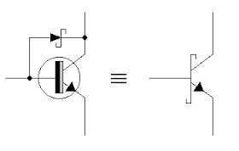
提高开关速度：
减小面积，减小电容；
掺金，减小少子寿命。
钳位二极管
钳位二极管的作用：
分流
降低V_{BC}: 从0.6-0.3V

Slide 14
新型高性能双极晶体管：
异质结晶体管（HBT）
多晶硅发射极晶体管
锗硅基区晶体管

Slide 15
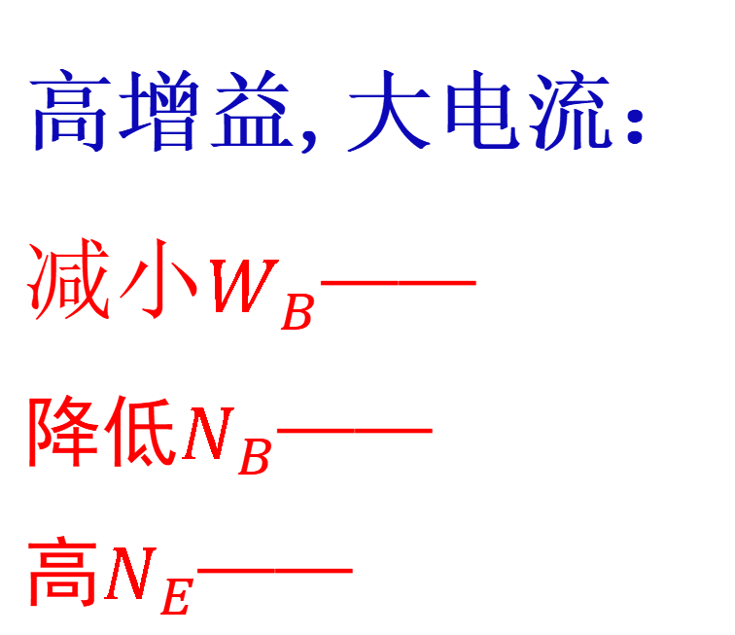
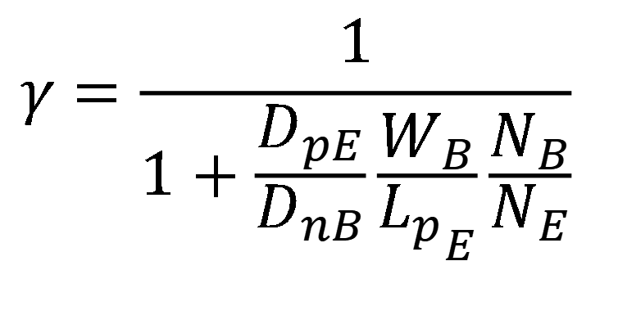
$$γ=\frac{1}{1+\frac{D_{pE}}{D_{nB}}\frac{W_{B}}{{L_{p}}_{E}}\frac{N_{B}}{N_{E}}}$$
高增益,大电流：
$减小W_{B}$——
降低$N_{B}$——
高$N_{E}$——

Slide 16
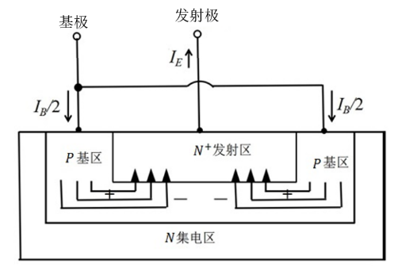
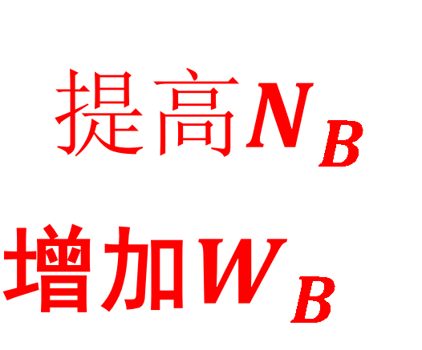
$${提高N}_{B}$$
增加$W_{B}$

Slide 17
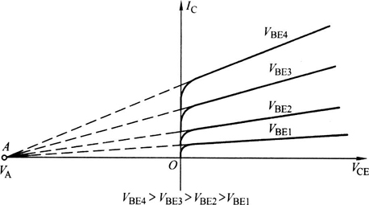
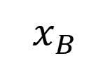
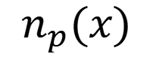
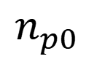
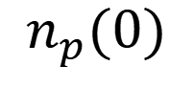
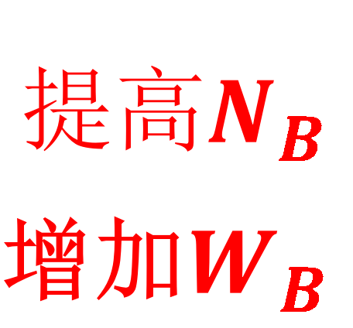
$$n_{p}(0)$$
$$n_{p}(x)$$
$$n_{p0}$$
$$x_{B}$$
$${提高N}_{B}$$
增加$W_{B}$

Slide 18




$${提高N}_{B}$$
增加$W_{B}$
$$减小W_{B}$$

Slide 19
异质结晶体管
异质结：不同材料之间形成的pn 结，具有许多独特的性质，在光电器件，量子效应器件及双极晶体管中有重要应用
发展概况：
19世纪50年代中期，H.Kroemr提出宽带隙材料作为发射区的HBT技术可提高晶体管的频率特性
1986年前后，IBM公司的Bernard, S.Meyerson等人利用
UHV/CVD技术制备了Si_{(1-x)} Ge_{x}
1987年，IBM S.S.Luyer等人，SiGe晶体管

Slide 20
The heterojunction bipolar transistor (HBT) is a type of bipolar junction transistor (BJT) which uses differing semiconductor materials for the emitter and base regions, creating a heterojunction. The HBT improves on the BJT in that it can handle signals of very high frequencies, up to several hundred GHz. It is commonly used in modern ultrafast circuits, mostly radio-frequency (RF) systems, and in applications requiring a high power efficiency, such as RF power amplifiers in cellular phones. The idea of employing a heterojunction is as old as the conventional BJT, dating back to a patent from 1951.

Slide 21
The principal difference between the BJT and HBT is in the use of differing semiconductor materials for the emitter-base junction and the base-collector junction, creating a heterojunction. The effect is to limit the injection of holes from the base into the emitter region, since the potential barrier in the valence band is higher than in the conduction band. Unlike BJT technology, this allows a high doping density to be used in the base, reducing the base resistance while maintaining gain. The efficiency of the heterojunction is measured by the Kroemer factor,^{[2]} named after Herbert Kroemer who was awarded a Nobel Prize for his work in this field in 2000 at the University of California, Santa Barbara.
Materials used for the substrate include silicon, gallium arsenide, and indium phosphide, while silicon / silicon-germanium alloys, aluminium gallium arsenide / gallium arsenide, and indium phosphide / indium gallium arsenide are used for the epitaxial layers. Wide-bandgap semiconductors are especially promising, e.g. gallium nitride and indium gallium nitride.
In SiGe graded heterostructure transistors, the amount of germanium in the base is graded, making the bandgap narrower at the collector than at the emitter. That tapering of the bandgap leads to a field-assisted transport in the base, which speeds transport through the base and increases frequency response.

Slide 22


Herbert Kroemer（赫伯特·克勒默） (born August 25, 1928), In 2000, Kroemer, along with Zhores I. Alferov, was awarded the Nobel Prize in Physics “for developing semiconductor heterostructures used in high-speed- and opto-electronics”. The other co-recipient of the Nobel Prize was Jack Kilby （杰克·基尔比）for his invention and development of integrated circuits and micro-chips.
Herbert Kroemer（赫伯特·克勒默）
Jack Kilby （杰克·基尔比）

Slide 23
He focused its semiconductor research program on the emerging compound semiconductor technology rather than on mainstream silicon technology.
Kroemer always preferred to work on problems that are ahead of mainstream technology. In the 1950s, he invented the drift transistor and was the first to point out that advantages could be gained in various semiconductor devices by incorporating heterojunctions. Most notably, in 1963 he proposed the concept of the double-heterostructure laser, which is now a central concept in the field of semiconductor lasers. Kroemer became an early pioneer in molecular beam epitaxy, concentrating on applying the technology to untried new materials.
Along with Charles Kittel he co-authored the popular textbook Thermal Physics, first published in 1980, and still used today. He is also the author of the textbook Quantum Mechanics for Engineering, Materials Science and Applied Physics.^{[2]}

Slide 24

电子亲和势——electron affinity
Vacuum level
χ ＝E₀-E_{C} 电子亲和势
随半导体表面状态而变化。在我们现在讨论问题过程中，认为它不变。不同材料有不同的电子亲和势
W＝E₀-E_{F} 功函数
随掺杂浓度而变化。
χ
W
E_{C}
E_{F}
E_{V}

Slide 25




$V_{bi}=E_{g2}$-$V_{n}−∆E_{V}−V_{P}=E_{g2}\text{−}V_{n}−V_{P}−∆E_{g}+∆E_{c}$
$=$ $E_{g1}+∆E_{c}{−V}_{n}−V_{P}$

Slide 26


Vacuum level
$$∆E_{V}$$

Slide 27
 | AlAs | GaAs
a | 5.6605 | 5.6533
E_{g} | 2.15 | 1.42
 | Si | Ge
a | 5.43 | 5.646
E_{g} | 1.12 | 0.67

Slide 28
HBT Material Structure | ΔEc (eV) | ΔEv (eV) | ΔEg (eV) | ΔEv/ΔEc
Al0.3Ga0.7As/GaAs | 0.24 | 0.13 | 0.37 | 0.54
In0.5Ga0.5P/GaAs | 0.19 | 0.29 | 0.48 | 1.53
InP/In0.53Ga0.47As | 0.25 | 0.34 | 0.59 | 1.36

Slide 29
结电容

Slide 33
N_{b}可提高至10²⁰/cm³
１、基区不容易穿通，从而厚度可以做小
２、R_{B}降低，f_{max}可提高
３、基区电导调制效应不明显，大注入效应不明显，改善大注入下的增益下降
４、基区电荷对输出电压不敏感，Early电压显著增大
N_{E}可降低到10¹⁷/cm³,
发射结耗尽层电容减少，电流放大截止频率f_{T}上升

Slide 35

四 几类常见的HBT
1、 AlGaAs/GaAs HBT
发射区：Al_{x}Ga_{1-x}As， x≈0.2，
x$>$0.2，N型AlGaAs中开始出现深施主，使发射结电容增加
x=0.25时，发射区的禁带宽度比基区的大0.39ev，注入效率可以显著提高。基区：P⁺-GaAs材料，$W_{B}:$0.05~0.1μm，N_{a}为5×10¹⁸~ 1×10²⁰ cm⁻³；
集电区: GaAs材料(N型)。
N＋-GaAs埋层和半绝缘GaAs(SiGaAs)衬底。SiGaAs是通过向GaAs引入深能级杂质(因而费米能级被钉扎在禁带中央)而获得的。
优点是：Al_{x}Ga_{1-x}As/GaAs材料体系可以有良好的晶格匹配；其次，由于采用半绝缘衬底，器件之间容易隔离和互连器件或互连线同衬底之间的电容可以忽略。此外，用来制作激光器、发光二极管、光探测器等光电于器件。

Slide 36
2、 InGaAs HBT
同InP晶格匹配的III-V族化合物半导体包括In_{0.53}Ga_{0.47}As和In_{0.52}Al_{0.48}As。 In_{0.53}Ga_{0.47}As的禁带宽是0.75eV。 In_{0.52}Al_{0.48}As的禁带宽度是1.5eV ，而InP的禁带宽度是1.35eV。用In_{0.53}Ga_{0.47}As作为基区而InP或In_{0.52}Al_{0.48}As作为发射区构成的HBT，其主要是In_{0.53}Ga_{0.47}As中的电子迁栘率很高；对于本征材料（无杂质散射），其迁栘率是GaAs的1.6倍，是Si的9倍。这类器件的半绝缘衬底采用掺Fe的InP。

Slide 37
3、Si/Si_{1-x}Ge_{x} HBT
加入Ge会降低Si的禁带宽度，形成可用于HBT基区的合金。由于Ge和Si的晶格常数(分别为0.56575和0.54310eV)相差超过4％，SiGe合金的晶格常数将比和Si的相差甚大，不可能实现晶格匹配；但是，如果合金层的度低于临界值， SiGe合金和Si之间可以弹性调节，从而不出现晶格失配，这就是所谓的应变层结构。这类HBT具有很高的注入效率；与化合物异质结器件相比，这类器件由于采用成熟的硅工艺，工艺简单、可靠，价格便宜，机械和导热性能良好，并且可以在同一衬底上集成电子器件和光电子器件；

Slide 38


Compound Semiconductor devices are used for the solar panels and the RF transmitters and receivers in communications satelites (pictured is a DirecTV satelite by Hughes Electronics).
Heterojunction bipolar transistor (HBT) consisting of an n-type GaAs collector, p+ GaAs base, only 20 nm thick, and an InGaP emitter. These devices amplify RF signals by 20 times at a frequency of 1.9 GHz.

Slide 39


High-speed, High-reliability 0.5-μm-emitter InP-based Heterojunction Bipolar Transistors
The fabricated HBT exhibits a current gain of 58, f_{t} of 321 GHz, and f_{max} of 301 GHz at a collector current density of 4 mA/μm². The results of accelerated life tests predict an activation energy of around 1.5 eV and the extrapolated mean time to failure is over 10⁸ hours at a junction temperature of 125ºC.

Slide 40


Thin Solid Films 521 (2012) 172–175
doi:10.1016/j.tsf.2011.12.081

Slide 41


锗硅基区晶体管
E_{g}(Ge)=0.67eV
E_{g}(Si)=1.12eV
结构特点：将锗引进基区中它的分布特点是靠近发射
结处要尽量小，而靠近集电结处要尽可能 大。也就是说两个晶体管发射结是相同的，不同的是集电结。

Slide 42

基区中平衡少子浓度随位置变化：
自建电场
自建电场的作用：
阻止少子扩散，维持基区准中性
加速注入少子的漂移运动，减小基区渡越时间
分析表明：如果禁带减小100meV,集电极电流和电流增益将提高48倍。Early电压增加12倍，基区渡越时间及发射极-基极充放时间降低2.5倍，截止频率得到提高

Slide 43


SiGe的制备方法有：
MBE、UHV/CVD等
较好的是：UHV、CVD，温度低、厚度均匀
SiGe基区BJT的结构和工艺
分子束外延MBE，超高真空化学气相沉积UHV/CVD

Slide 44


0.12×1.0µm device hit 510GHz at 4.5K and 352GHz at 300K. BV_{CEO} was 1.36V (1.47V at 300K
Base width is about 20 nm

Slide 45

多晶硅发射极晶体管
常规晶体管示意图
为降低杂散电容及串联电阻，发射区越薄越好，这导致发射区中少子浓度梯度增大，空穴电流增加，注入比降低，从而电流增益降低。

Slide 46



多晶硅发射极晶体管示意图
多晶硅中载流子迁移率低，扩散系数小

Slide 47

HBT是什么是缩写？总结一下HBT的优势
画能带图

